Slide 1

Rest Template
Architecture
11/10/2022

Slide 2

Error Handling
To call any external service most likely you will be using a RestTemplate. A RestTemplate can throw three types of exception as listed below :
HttpClientErrorException : For 4xx series status codes or Client errors.
HttpServerErrorException : For 5xx series status codes or server errors
RestClientException : Any other status codes like 3xx series
Usage :
There are two steps to using “ResponseErrorHandler” :
Create a custom error handler class by implementing ResponseErrorHandler and implements its methods hasError and handleError. First methods should check if there is an exception and if it returns true then only handle error method gets called.
Next step is to set the custom error handler to RestTemplate by using RestTemplateBuilder

Slide 3
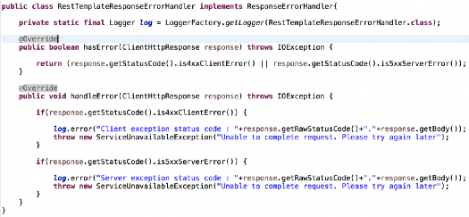

STEP 1
Error Handling

Slide 4
Fin

